Slide 1




The Container Revolution
Jimmy Bogard
@jbogard
github.com/jbogard
jimmybogard.com

Slide 2
My Journey
What is container
What problems do they solve
How does it fit into daily work
How does it fit into our normal CI/CD pipeline

Slide 3

DISCLAIMER:

Slide 4

?

Slide 5

DISCLAIMER:

Slide 6
Containers
Zones
jails
VM
Not a thing
Cgroups
Namespaces
Lsms
etc
A thing
A thing
A thing

Slide 7


Slide 8
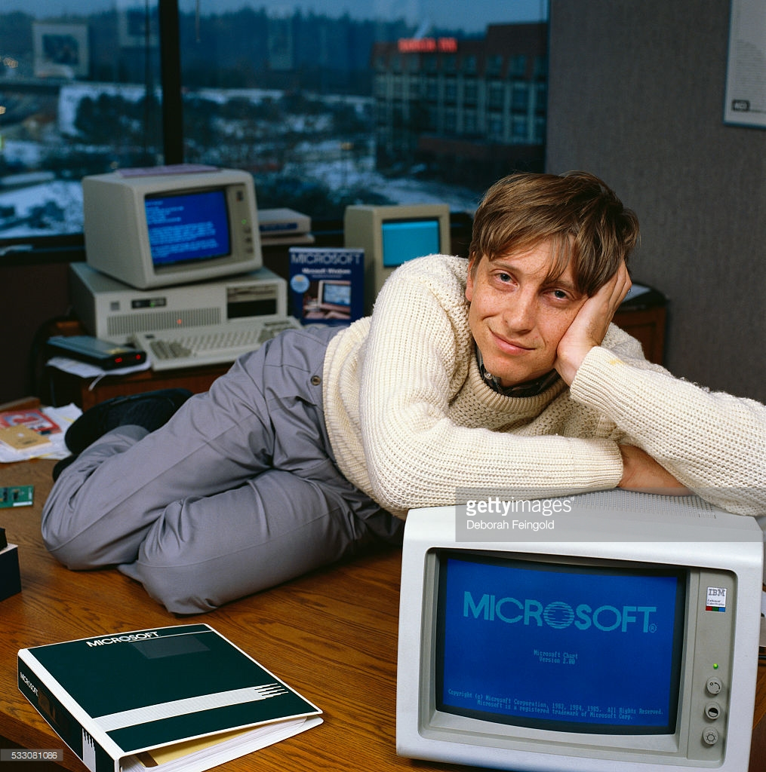
?

Slide 9


Windows Server Containers
Hyper-V Isolation
Process isolation
Namespace isolation
Shares kernel
Not secure!
WSC inside optimized VM
Security of VMs
Simplicity of containers
But in Hyper-V

Slide 10
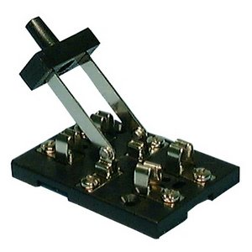
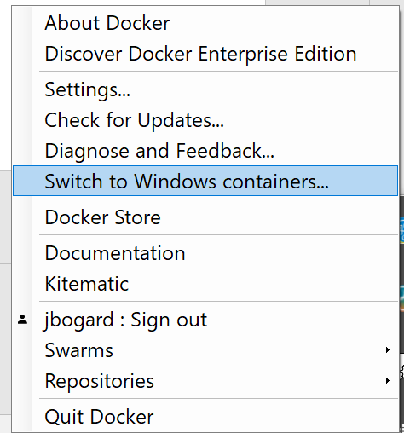

Slide 12
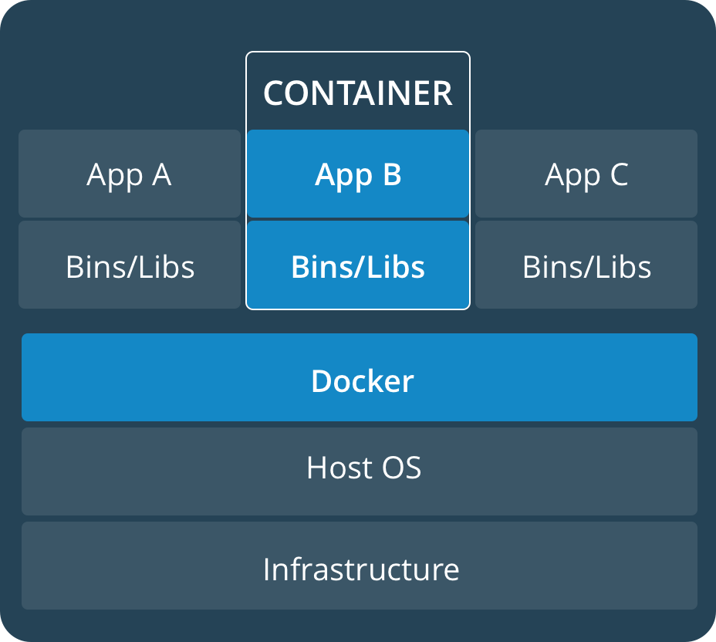
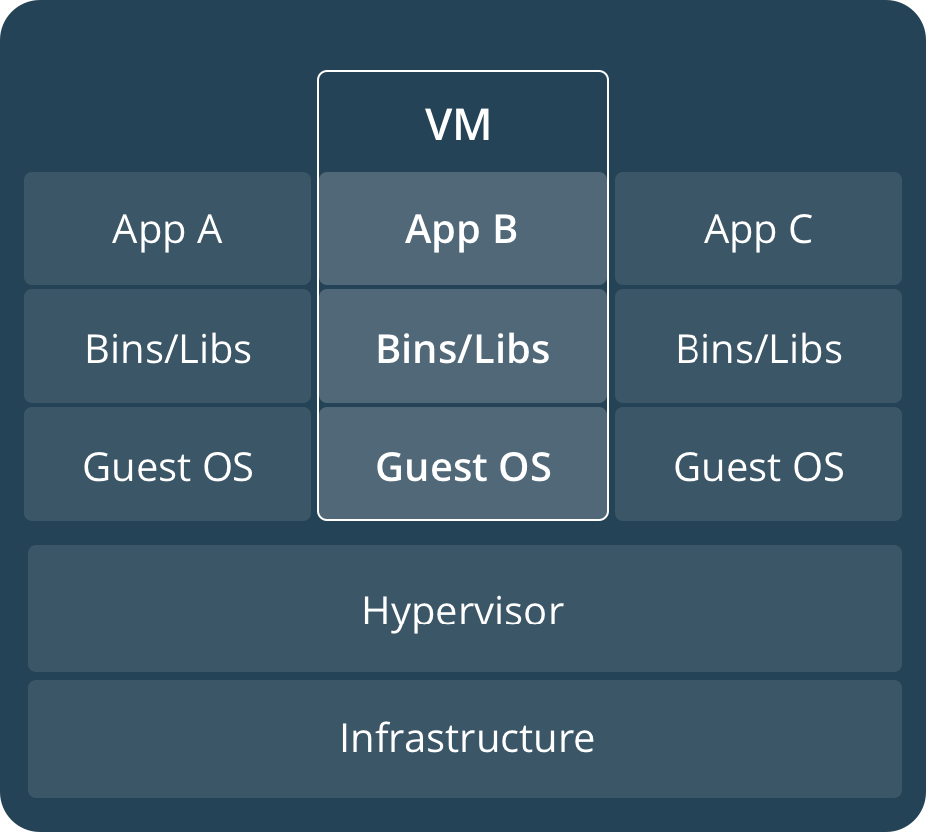

Slide 13
Semi-Accurate Docker Terminology
Dockerfile =/= "build.ps1"
Image =/= "foo.exe"
Container =/= "$ foo.exe"
Docker-compose =/= "foo.sln"
Docker Hub =/= NuGet server

Slide 14
Quick File->New Demo

Slide 15


Before

Slide 16




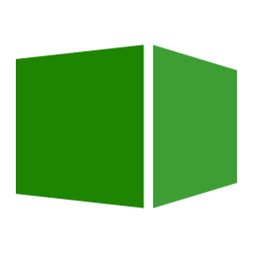

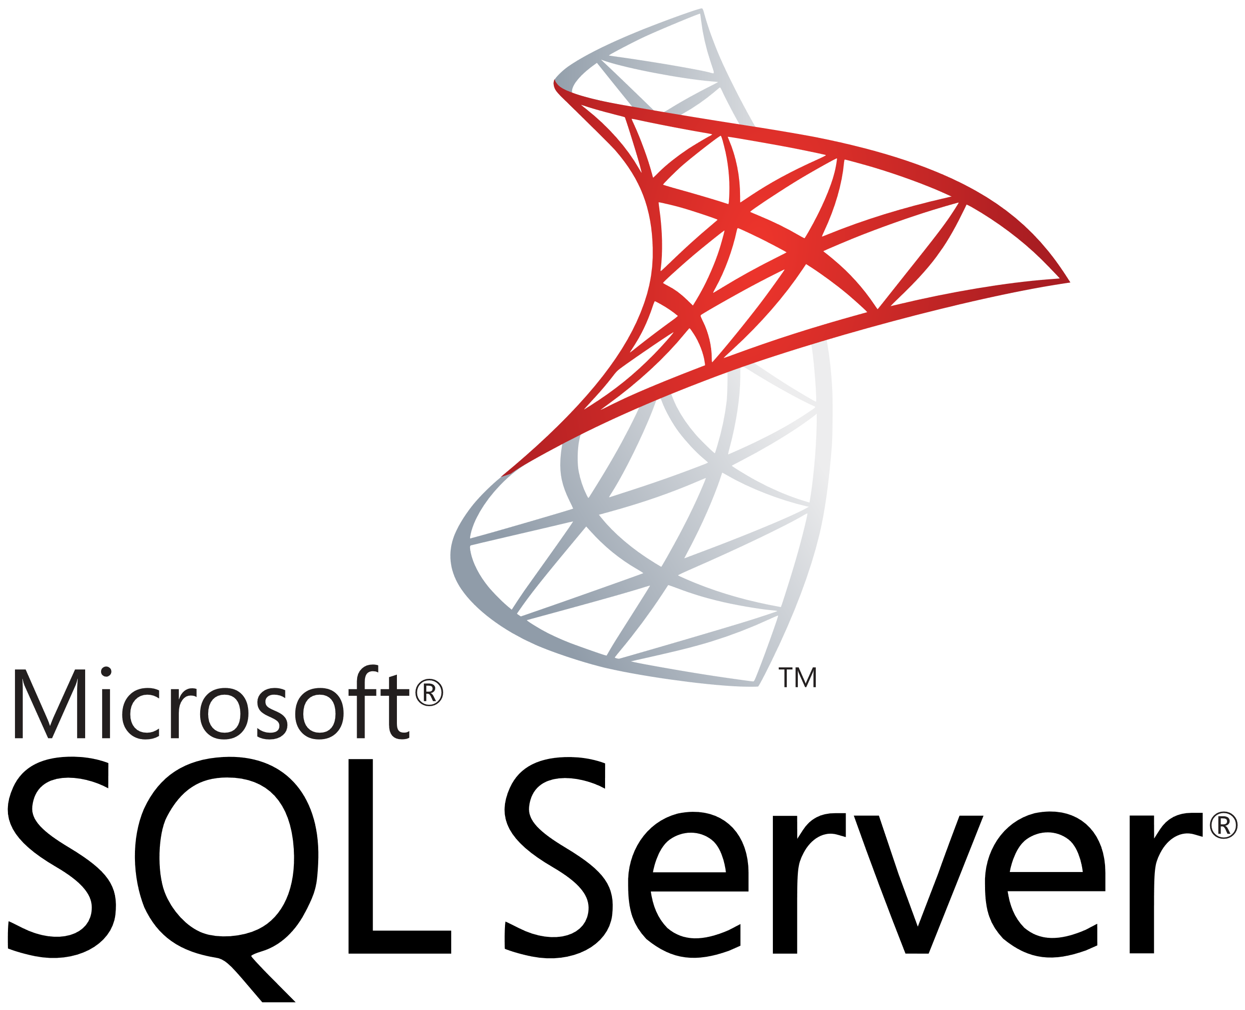







Codey McCodeface
Code Repo
Packages
Production
Continuous Integration
Continuous Delivery

Slide 17
Coder McCodeyface

Slide 18
Codey McCodeface
Virtual Machine

Slide 19



Codey McCodeface
Docker

Slide 20
Demo (Respawn)

Slide 21
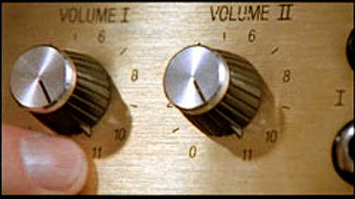
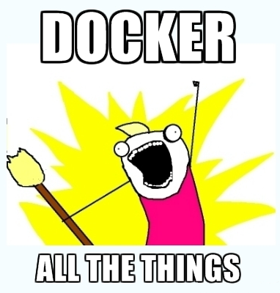

Slide 22
Codey McCodeface
Docker

Slide 23
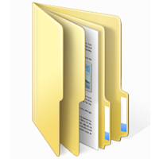
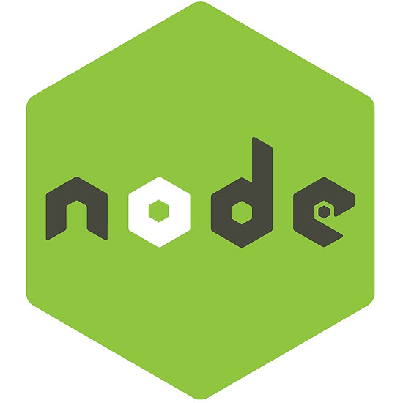
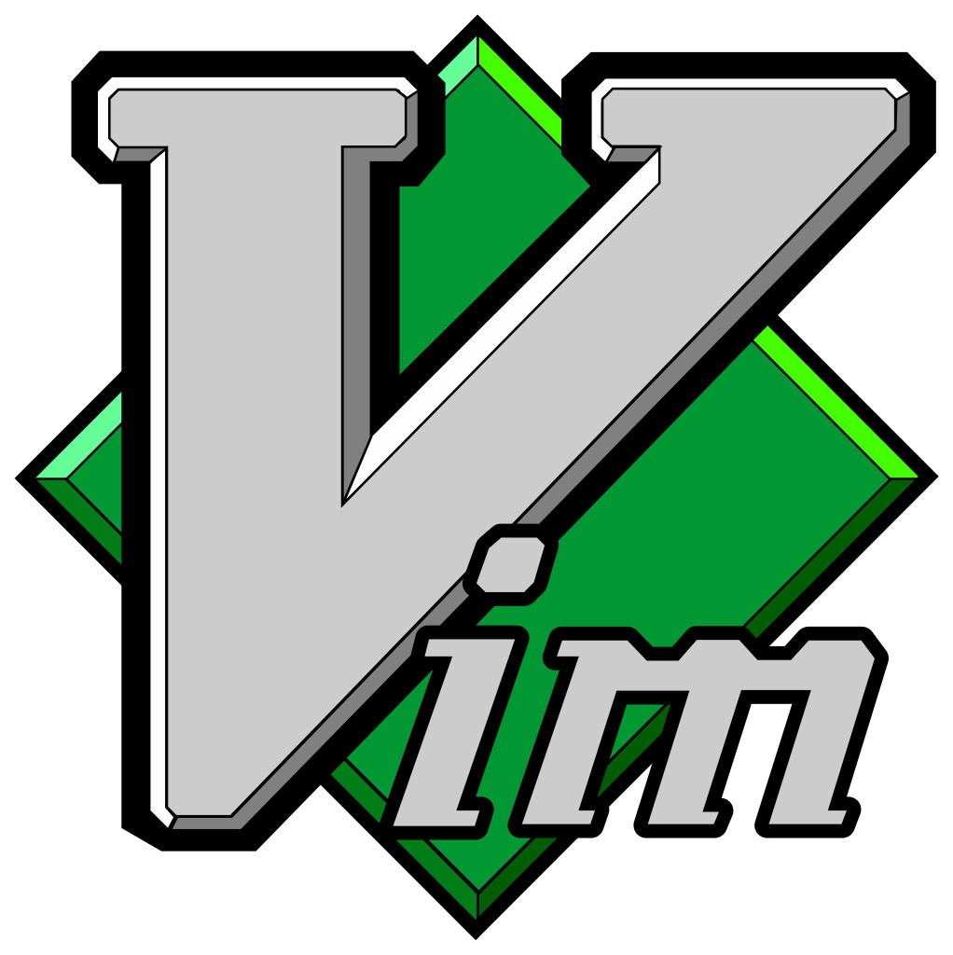
Codey McCodeface
Docker
.ssh
node_modules
.gitconfig

Slide 24
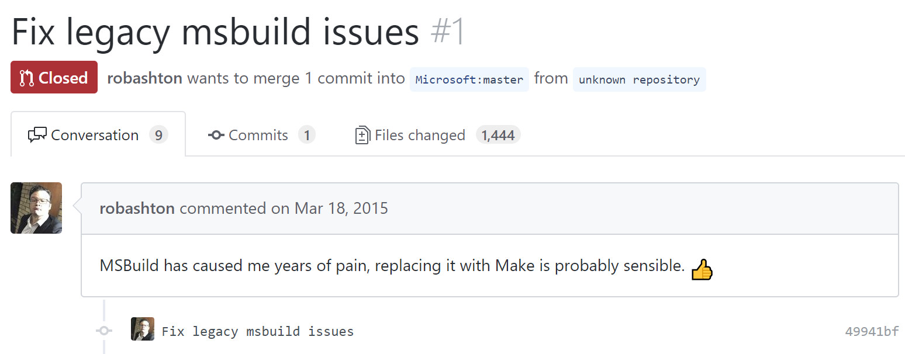

Slide 25
Demo (Real Project)

Slide 26
?

Slide 27
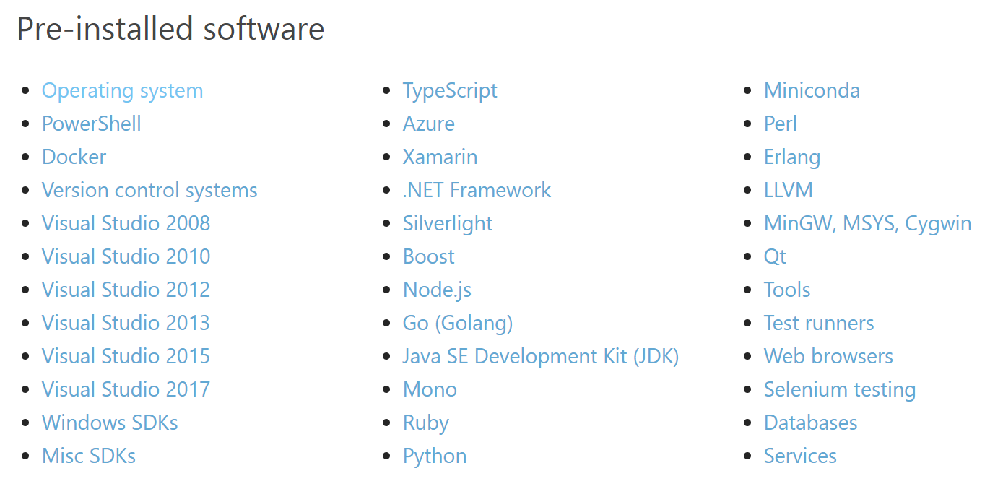
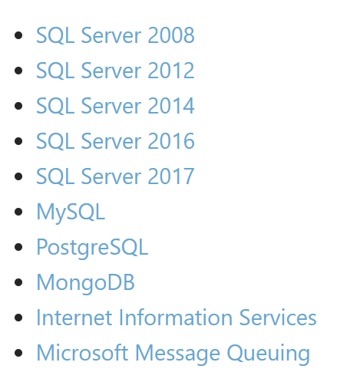
Hyper-V

Slide 28
Demo

Slide 29
?

Slide 30
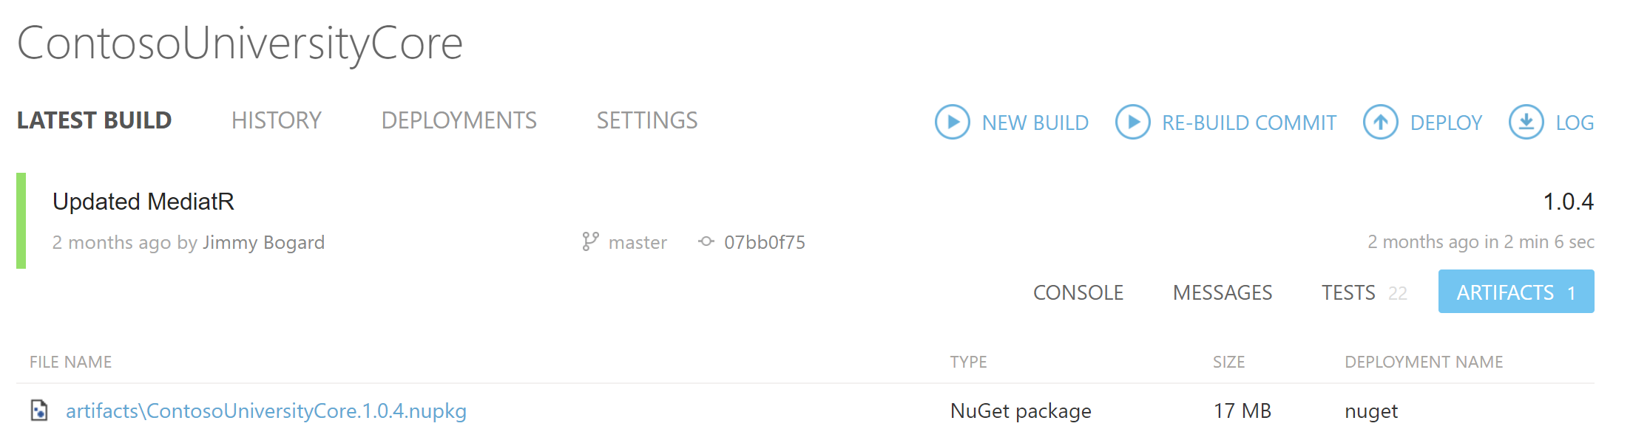

Slide 31
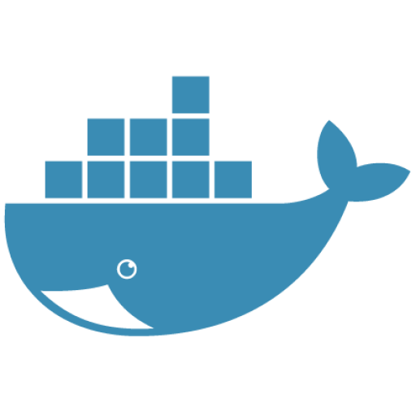

Slide 32
Final Lessons
Good for local dev dependencies
Lousy for Windows dev environment
Windows images too big for hosted CI/CD
Could be a good replacement for NuGet as the "app"

